Slide 1
AIA Data Scientist Assessment

Slide 2
Data Mapping
B
PURPOSE_CODE
CHAR_VALUE
CHAR_VALUE2
AGENT
AGT_CHANNEL
AGT_STATUS
AGT_CD
MAIN
POLICY_NO
AGT_CD
S_BASE
RIDER_CD
COVERAGE_TYPE_IND
INS_UNIQUE_ID
PURCHASE_DT
PROD_CAT
PRODUCT_CD
ANP_RIDER Annualized New Premium
VIT_MBR_IND
PROD_SUBCAT_IND_1
PROD_SUBCAT_IND_2
C
PURPOSE_CODE
CHAR_VALUE
CHAR_VALUE2
CASE
WHEN PROD_CAT is NOT NULL THEN PROD_CAT WHEN PROD_SUBCAT_IND_1 = 1
AND
(PROD_SUBCAT_IND_2 = 1 OR MAIN_NEED IN ('Medical','Other Medical','Critical Illness’) )
THEN 'Cat 2’
ELSE 'Cat 3' END
D
PURPOSE_CODE
CHAR_VALUE
CHAR_VALUE2
E
PURPOSE_CODE
CHAR_VALUE
CHAR_VALUE2
CASE
WHEN MAIN.S_BASE = 'POLA' THEN 'Accident’
WHEN TRIM(D.CHAR_VALUE) IS NOT NULL THEN TRIM(D.CHAR_VALUE)
WHEN TRIM(E.CHAR_VALUE) IS NOT NULL THEN TRIM(E.CHAR_VALUE)
WHEN TRIM(B.CHAR_VALUE) IS NOT NULL AND TRIM(B.CHAR_VALUE) <> 'Medical' THEN TRIM(B.CHAR_VALUE)
WHEN TRIM(B.CHAR_VALUE) IS NOT NULL AND TRIM(B.CHAR_VALUE) = 'Medical' THEN 'Other Medical’
WHEN TRIM(C.CHAR_VALUE) IS NOT NULL AND TRIM(C.CHAR_VALUE) <> 'Medical' THEN TRIM(C.CHAR_VALUE)
WHEN TRIM(C.CHAR_VALUE) IS NOT NULL AND TRIM(C.CHAR_VALUE) = 'Medical' THEN 'Other Medical’
END

Slide 3
Data Understanding
Each POLICY_NO attached to unique Agent
COVERAGE_TYPE_IND have 2 values; B (Basic) and R (Rider). One POLICY_NO have 1 B only and multiple R
3 Types of S_BASE;
POLA – No Rider and No RIDER_CD for POLA. Only for MAIN_NEED=‘Accident’.
LAT - B type have RIDER_CD=10100
LA – B type have RIDER_CD=10100
PROD_CAT have 3 categories
Cat 1 – Life and Endowment. Always a Basic policy. Only become Rider if another Cat 1 is B.
Cat 2 – Income (all PROB_SUBCAT_IND_2 = 1) and Medical Related (only if PROB_SUBCAT_IND_1 = 1)
Cat 3 – Include all insurance type
Column | Definition
AGT_CD | Unique Identifier for Agent
S_BASE | Portfolio policies belong to.
POLICY_NO | Unique Identifier for Policies.
RIDER_CD | Rider Identifier, rider can briefly be understood as Add-Ons to a policy.
COVERAGE_TYPE_IND | Indicator of whether it is a Rider or Basic. 'B' = Basic, 'R' = Rider
EFFT_DT_RIDER | The purchase date of a particular policy or rider.
PROD_CAT | Part of the Product Categories we are interested in, have to be further processed to get the complete product categories.
PRODUCT_CD | Product Code, have to be joined to be meaningful.
ANP_RIDER | Annualized New Premium of a policy or rider.
VIT_MBR_IND | Indicator of whether a policy or rider is vitality attached.
PROD_SUBCAT_IND_1 | Indicator to be used when deriving the PROD_CAT in the challenge. (Distinct value (1 or 0) for each Policy)
PROD_SUBCAT_IND_2 | Indicator to be used when deriving the PROD_CAT in the challenge. (1 for Income Policy, else 0)

Slide 4
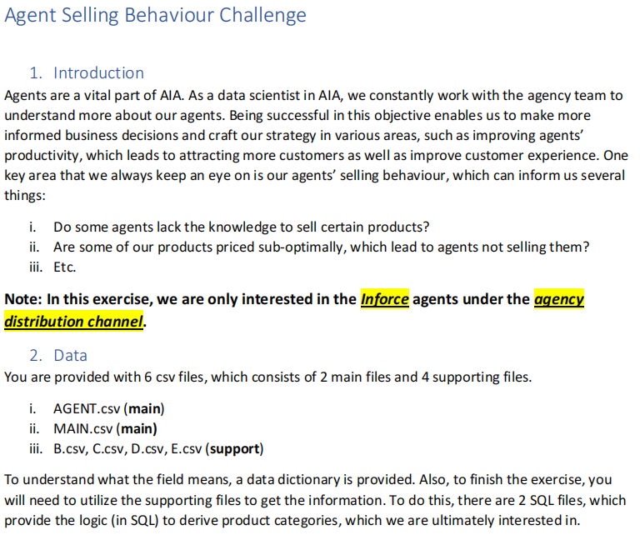

Slide 5
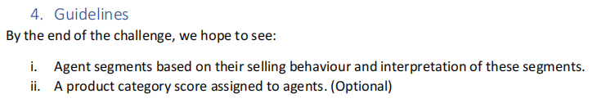
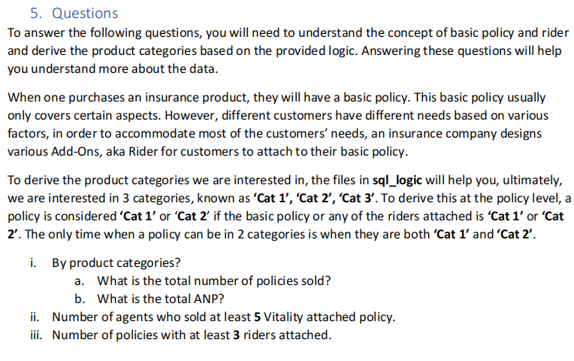

Slide 6


